Slide 1


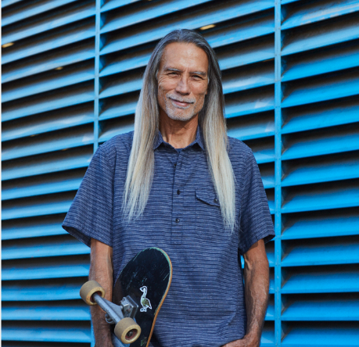




Lessons From the All of Us Research Program: Stakeholder-Guided Return of DNA Results to a Diverse Research Cohort
2023 Government UX Summit: Driving Innovation Through Inclusion
June 14, 2023
1

Slide 2


Speakers
Jennifer Shelley, MMC, MS (she/her)
Content Strategist, Science Communications
Division of Communications
All of Us Research Program
National Institutes of Health
jennifer.shelley@nih.gov
Leslie Westendorf, MFA, BFA (she/her)
Contractor, Director of UX Strategy
Division of User Experience
All of Us Research Program
National Institutes of Health
leslie.westendorf@nih.gov

Slide 3
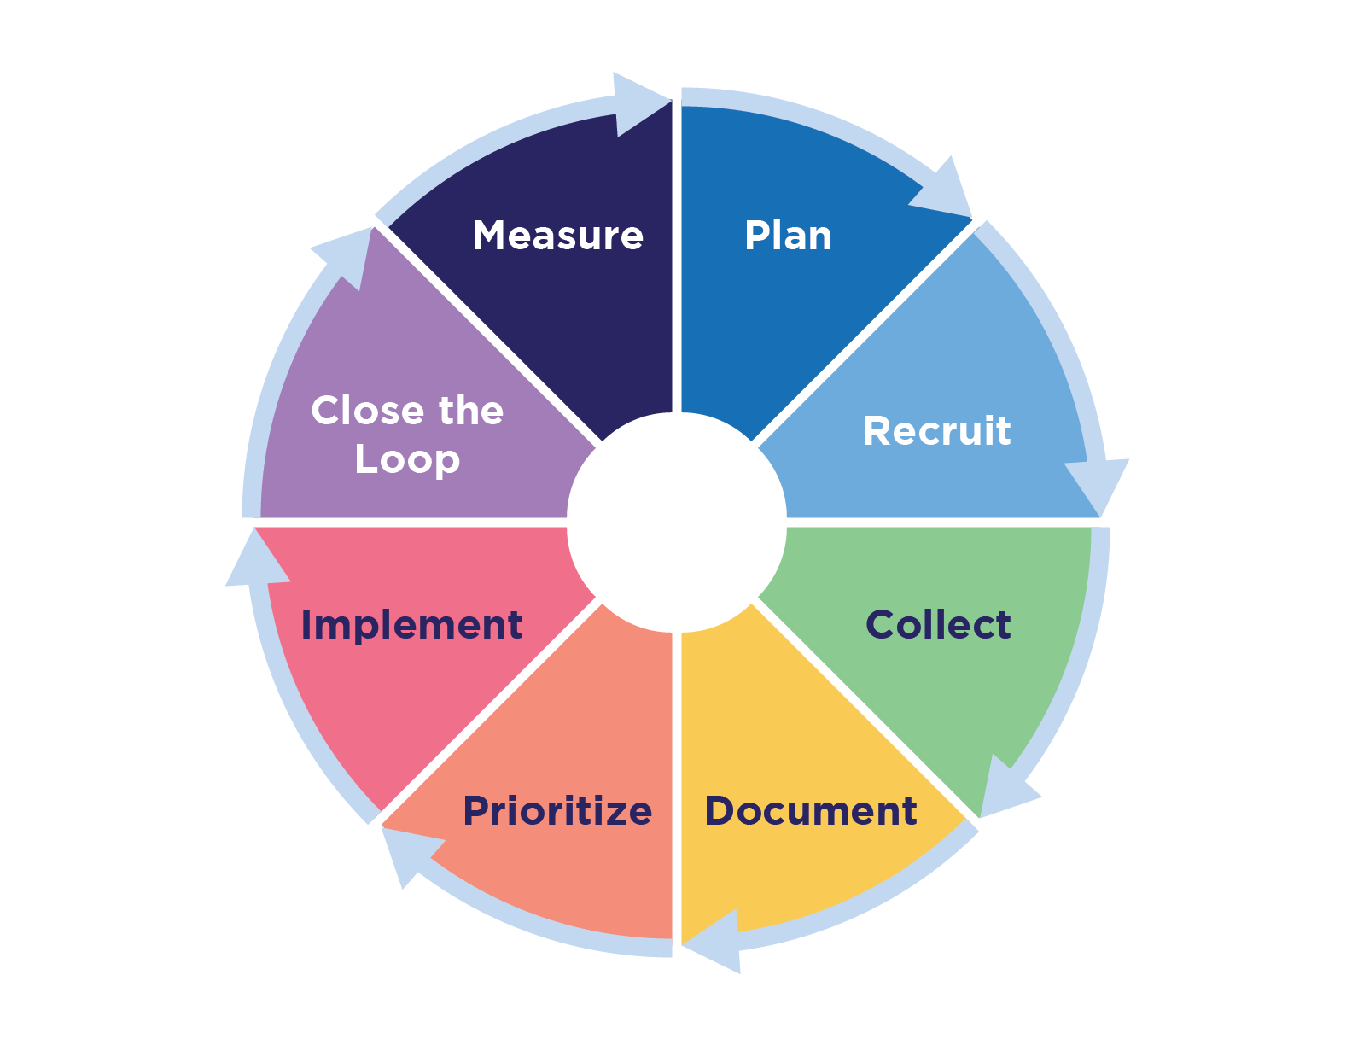
Our Topic: A Stakeholder Feedback Model
We developed this model based on our experience delivering an inclusive user experience to a diverse community that meets plain language and accessibility standards, reflects cultural competency, and promotes trust.

Slide 4
About the NIH All of Us Research Program
4

Slide 5




What Is the NIH All of Us Research Program?
The All of Us Research Program has a simple mission. We want to speed up health research.
To do this, we’re asking at least 1 million people from across the country to share their health information.
Researchers use this information to conduct thousands of studies, accelerating health discoveries and enabling individualized health care for all of us.
“All of Us is among the most ambitious research efforts that our nation has undertaken!”
Francis Collins, M.D., Ph.D. Former NIH Director, Science Advisor to the President, Co-Chair of the President’s Council of Advisors on Science and Technology
All of Us, All of Us logo, and “The Future of Health Begins With You” are registered service marks of the U.S. Department of Health and Human Services.

Slide 6
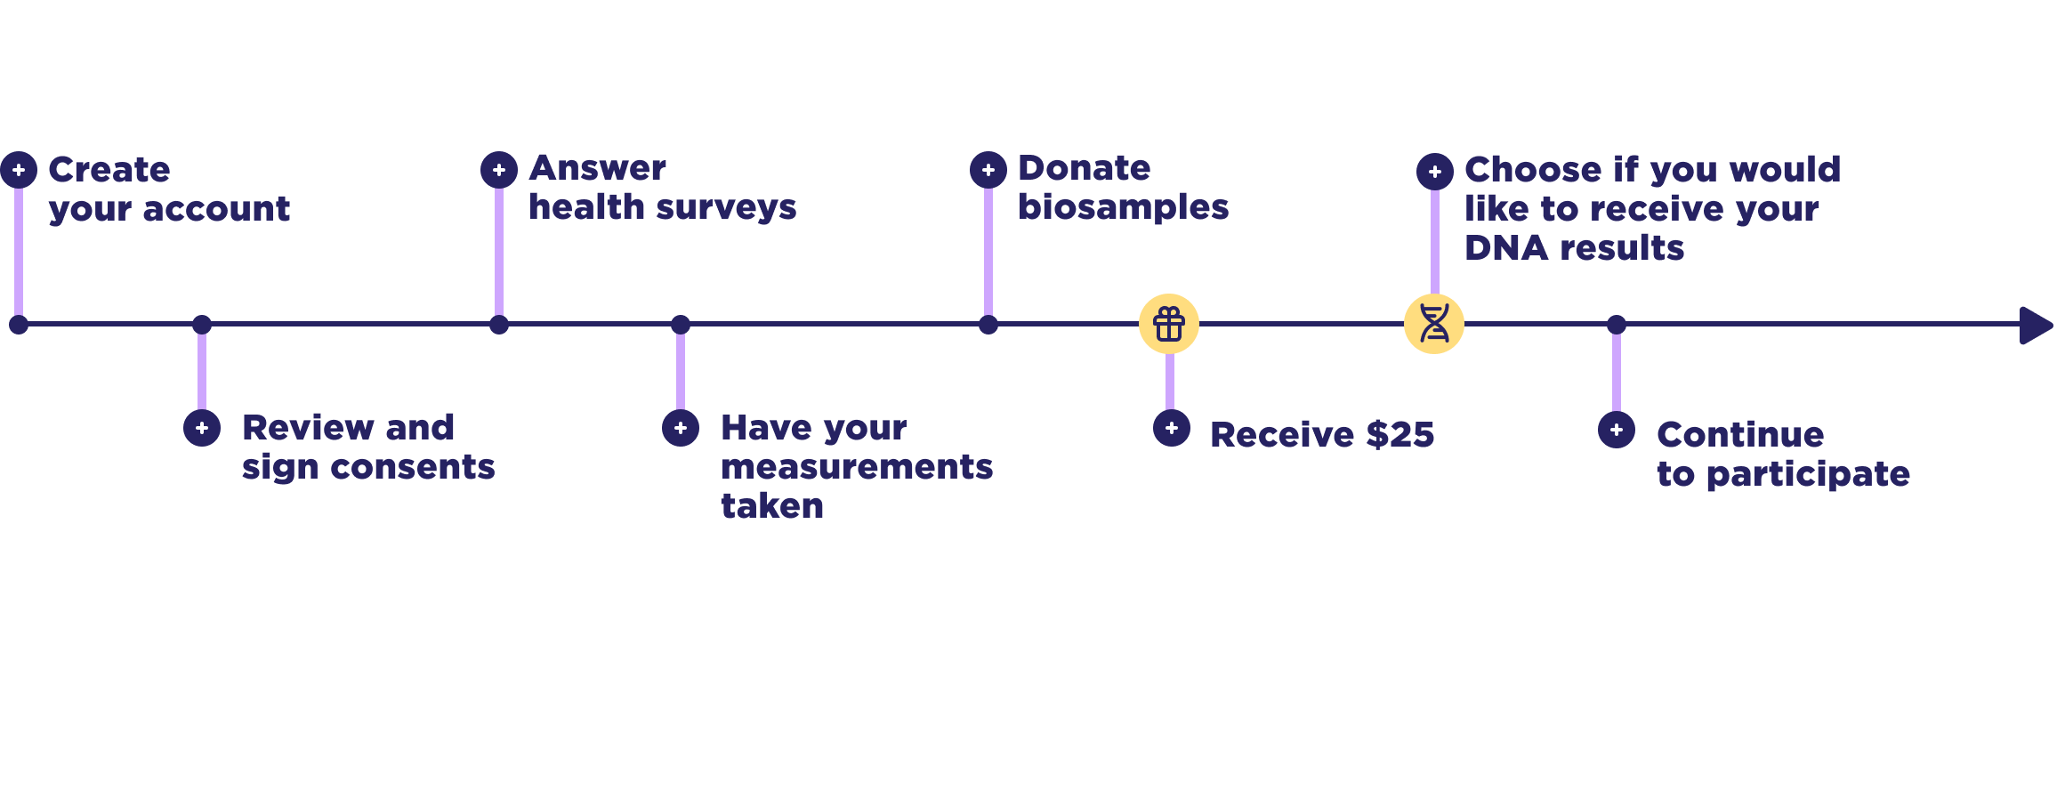
The All of Us Participant Journey
Notes:
Note: This diagram was produced by the HHS/NIH All of Us Research Program.

Slide 7
Anticipated Participant Barriers
Lack of trust in government
Experiences with systemic and structural racism or discrimination
Varying health literacy levels
Varying digital literacy levels
Accessibility
Barriers to health care access
Participants are essential to identifying solutions to the barriers and ensuring an inclusive, accessible, easy to use, satisfying experience.

Slide 8

All of Us Trusted Network of Partners

Slide 9
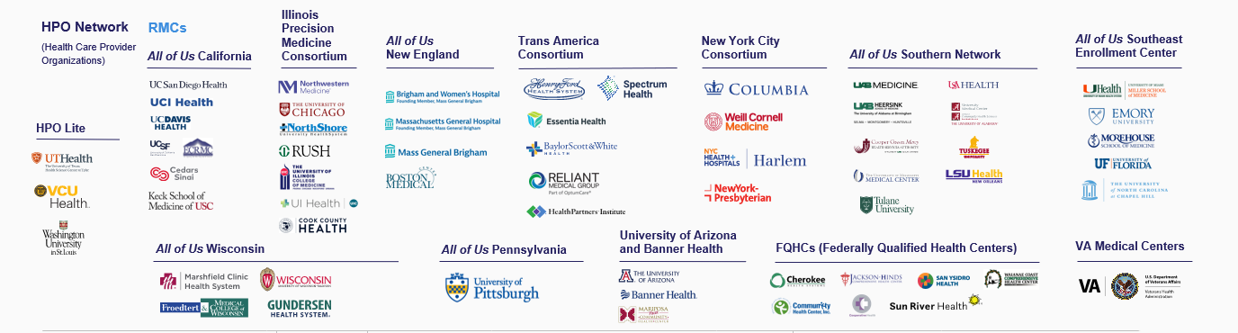
… and Consortium Members

Slide 10
Anticipated Program Challenges
Many and different stakeholder groups
Widespread interest in providing feedback at different levels
Each feedback opportunity leads to requests for more feedback opportunities

Slide 11
Multiple Feedback Methods Used Across Different Teams
Webinars
Surveys
Focus groups
Listening sessions
Comprehension testing
Content reviews by subject matter experts
Content reviews by stakeholder volunteers
Usability testing
Cultural Awareness Committee
IRB review
FDA exemption review
Friends & family soft launch

Slide 12
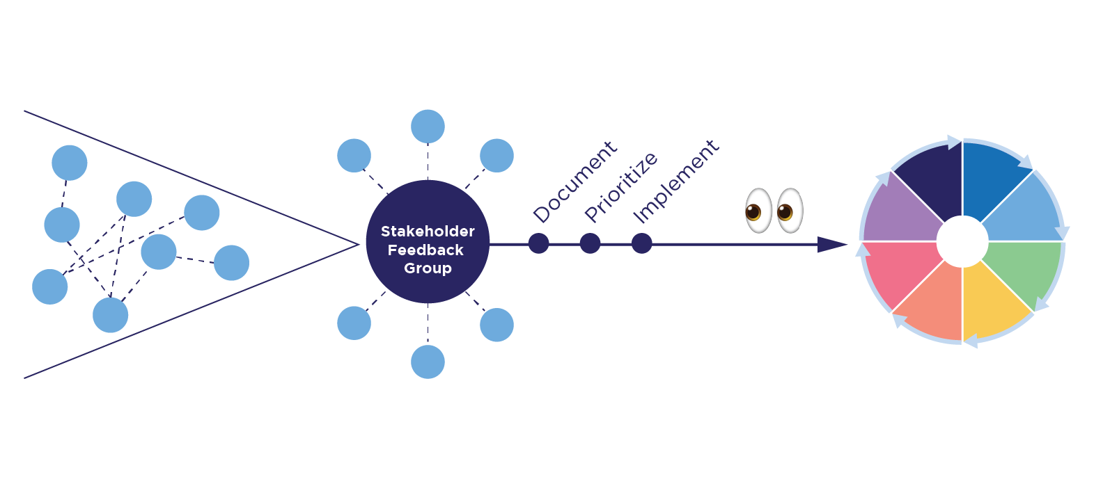
Evolving a Stakeholder Feedback Model
Phase 1: Ad-hoc
Phase 2: Centralized
Phase 3: Intentional
Notes:
Note: This diagram was produced by the HHS/NIH All of Us Research Program.

Slide 13
Evolving a Stakeholder Feedback Model
13

Slide 14
A Stakeholder Feedback Model
Methods used to gather, analyze, and evaluate stakeholder feedback
Lessons learned that informed our stakeholder feedback model
Signs of success showing the impact of stakeholder feedback
Notes:
Note: This diagram was produced by the HHS/NIH All of Us Research Program.

Slide 15
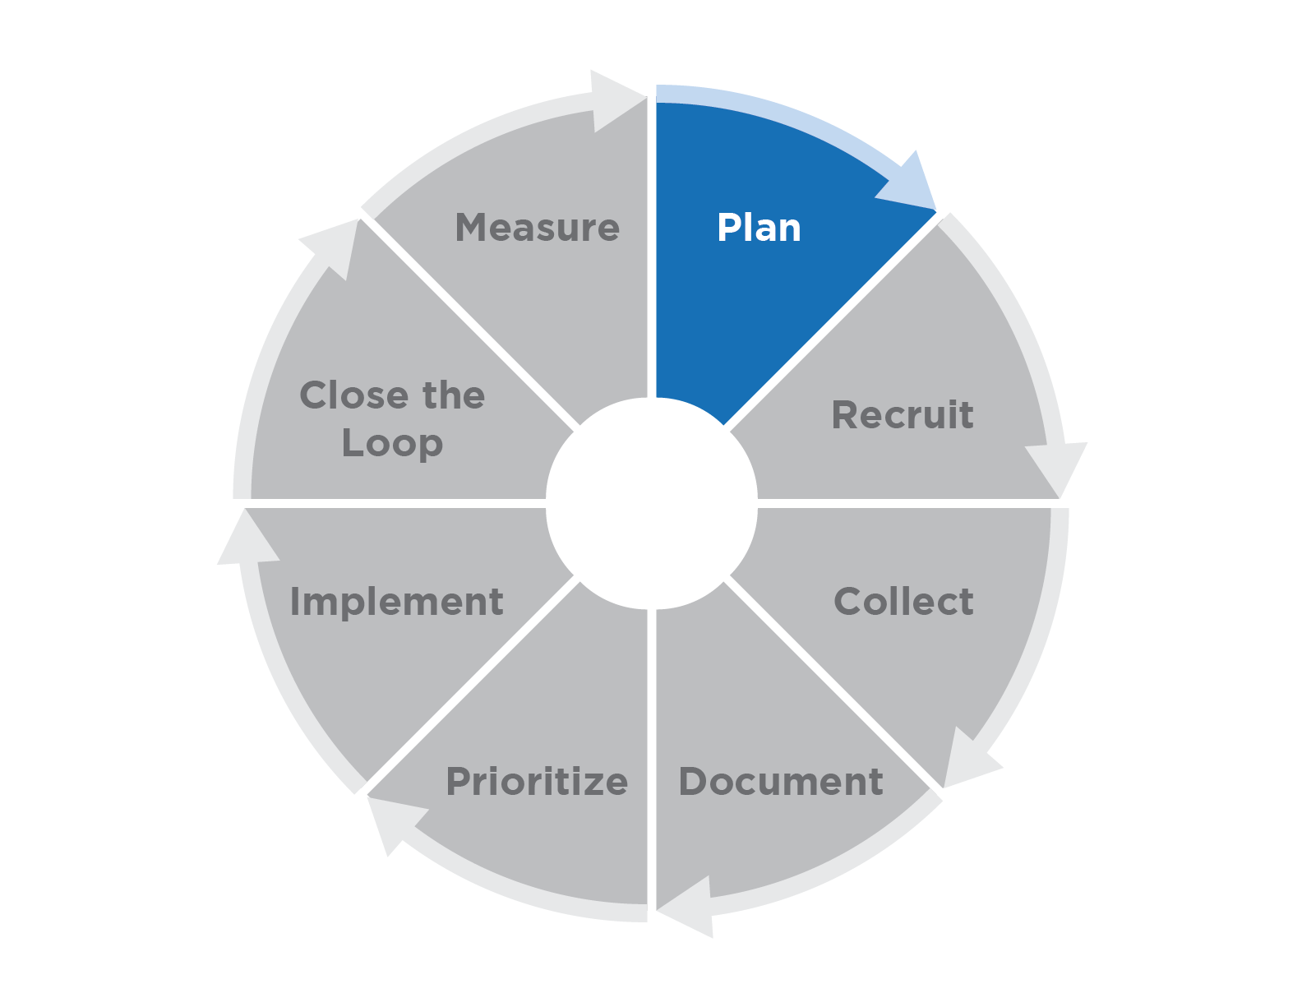
Plan
What to Do
Define your problem/question.
Document any available baseline metrics.
Select a rubric to help prioritize feedback in a consistent way.
Identify “deciders” for conflicting feedback.
Decide on success metrics and targets.
Notes:
Note: This diagram was produced by the HHS/NIH All of Us Research Program.

Slide 16
Plan (continued)
Lessons Learned
If there are no baseline metrics, it will be difficult to measure the impact of the stakeholder feedback.
If no “decider” is identified, it will be difficult to determine how to manage conflicting feedback.
Notes:
Note: This diagram was produced by the HHS/NIH All of Us Research Program.

Slide 17
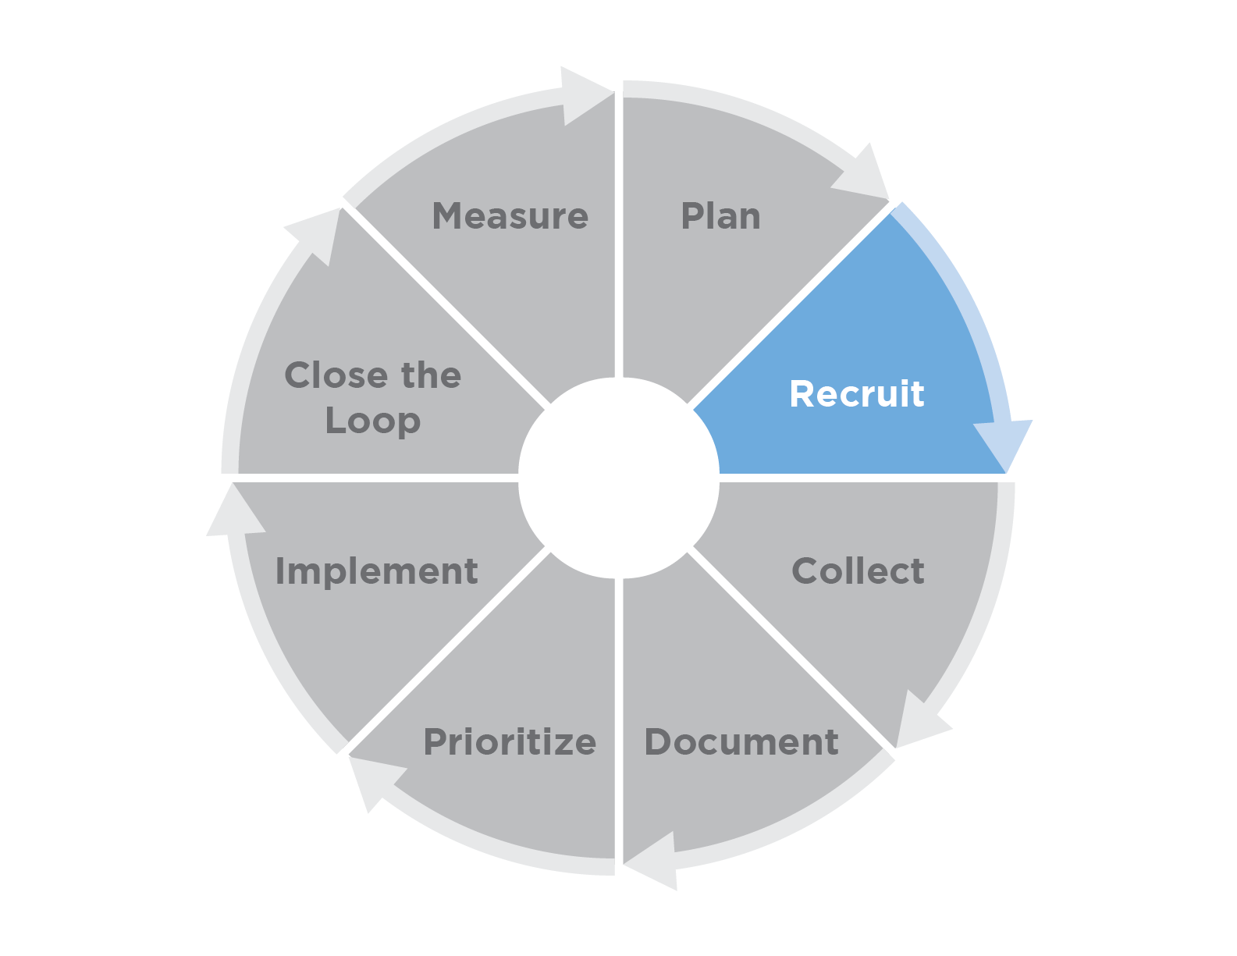
Recruit
What to Do
Identify potential stakeholder groups based on the defined problem/question.
Invite representatives from the stakeholder groups.
Specify the scope and set expectations.
Explain how you will close the loop after stakeholders provide feedback.
Notes:
Note: This diagram was produced by the HHS/NIH All of Us Research Program.

Slide 18
Recruit (continued)
Lessons Learned
Start early.
If the scope/ask is not clear, then feedback may not be usable or may be out of scope.
Notes:
Note: This diagram was produced by the HHS/NIH All of Us Research Program.

Slide 19
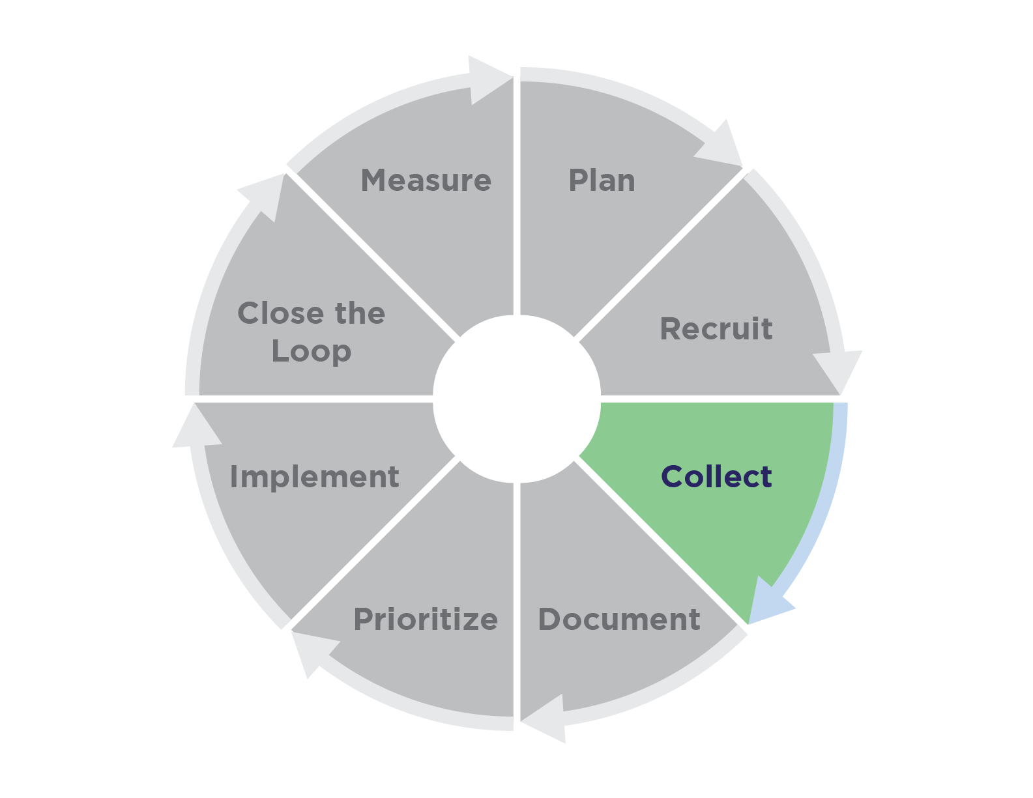
Collect
What to Do
Identify the method(s) you will use to capture the feedback.
Notes:
Note: This diagram was produced by the HHS/NIH All of Us Research Program.

Slide 20
Collect (continued)
Lessons Learned
Focus on asking questions.
Tailor feedback-collection methods to the stakeholders and the question.
Provide asynchronous feedback-collection methods.
Set deadlines.
Notes:
Note: This diagram was produced by the HHS/NIH All of Us Research Program.

Slide 21
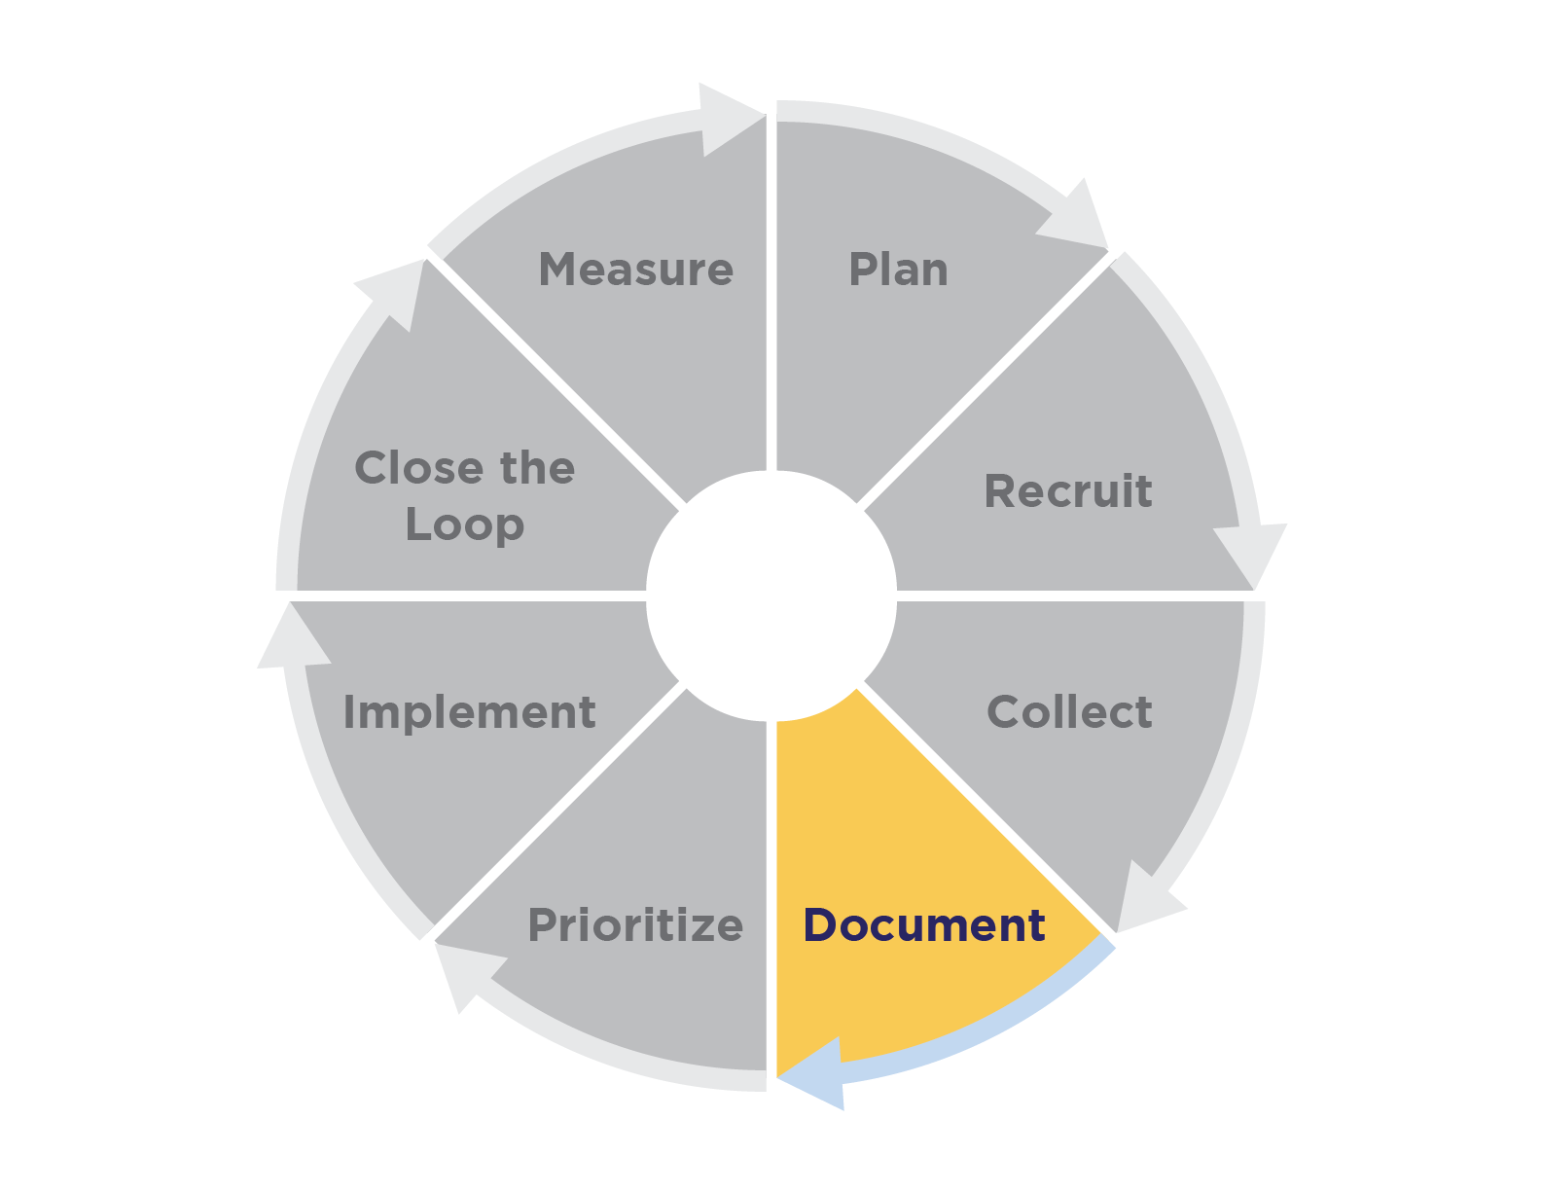
Document
What to Do
Determine how and where to document the feedback.
Develop a system to organize the feedback.
Notes:
Note: This diagram was produced by the HHS/NIH All of Us Research Program.

Slide 22
Document (continued)
Lessons Learned
Document centrally from the beginning.
Organize the feedback as you are receiving it.
Make the feedback accessible to all individuals and teams who will help prioritize and implement feedback.
Notes:
Note: This diagram was produced by the HHS/NIH All of Us Research Program.

Slide 23
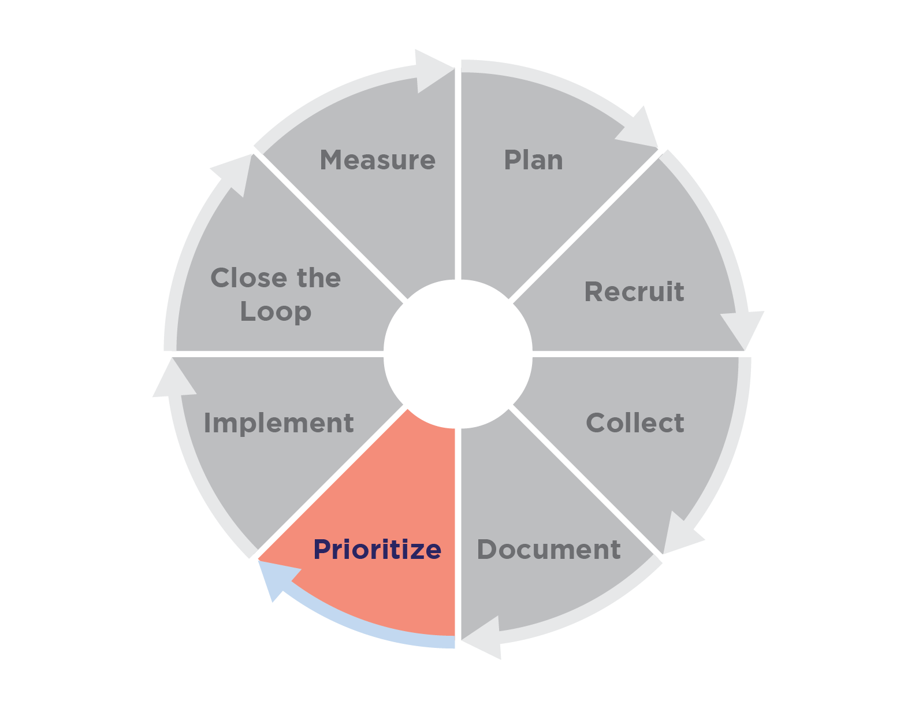
Prioritize
What to Do
Apply the evaluation rubric to all feedback.
Consult all individuals and teams responsible for implementing the feedback.
Consider constraints, such as budgets, timelines, and launch targets.
Notes:
Note: This diagram was produced by the HHS/NIH All of Us Research Program.

Slide 24
Prioritize (continued)
Lessons Learned
During the Plan step, identify a method you can use to evaluate all the feedback consistently.
Individuals who prioritize the feedback are not always the same individuals or teams who will implement the feedback.
Often, additional individuals or teams will need to help analyze the feedback and constraints, especially if technical implementation is required.
Notes:
Note: This diagram was produced by the HHS/NIH All of Us Research Program.

Slide 25
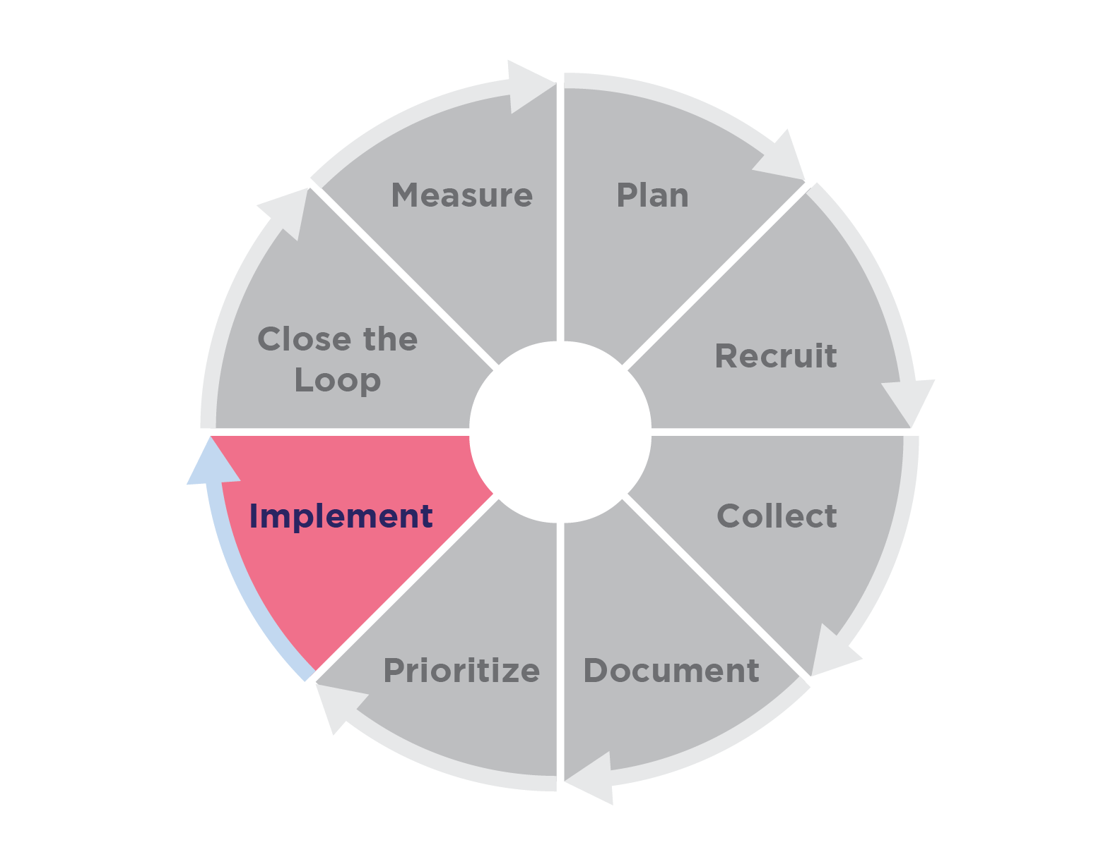
Implement
What to Do
Implement changes based on stakeholder feedback.
Test the changes, or launch, depending on where you are in your project lifecycle.
Notes:
Note: This diagram was produced by the HHS/NIH All of Us Research Program.

Slide 26
Implement (continued)
Lessons Learned
Coordinate implementation across all individuals or teams involved in the project.
Use implementation as an opportunity to gather more feedback.
Notes:
Note: This diagram was produced by the HHS/NIH All of Us Research Program.

Slide 27
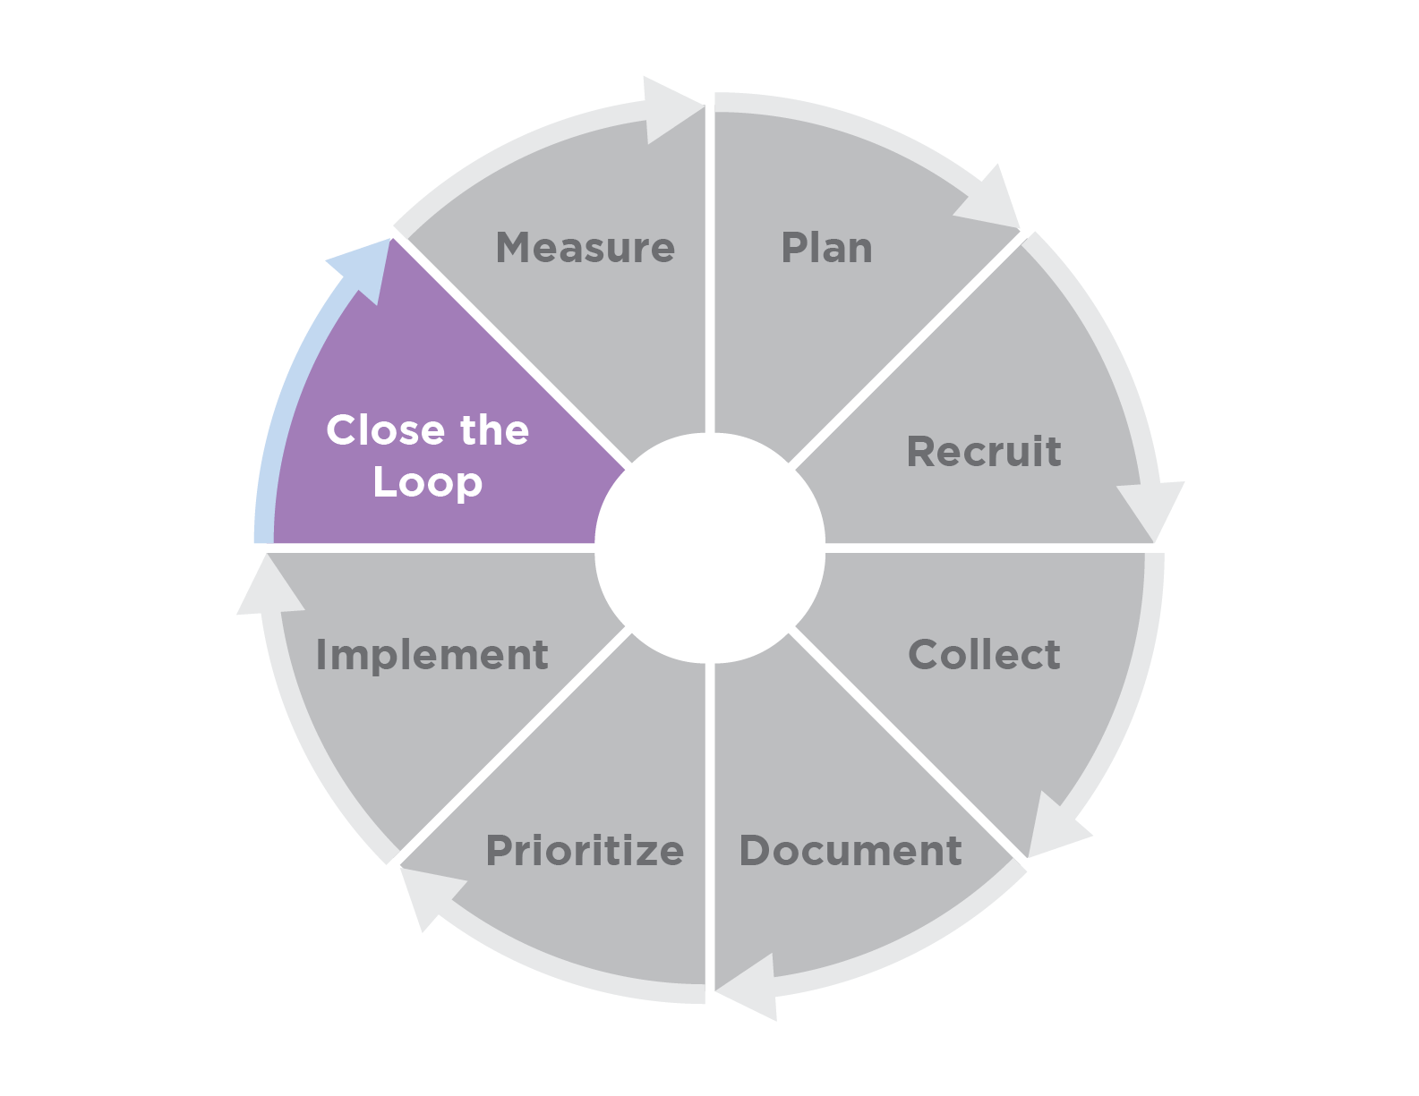
Close the Loop
What to Do
Report back to the stakeholders. Tell them what was implemented, what was not, and why.
Thank the stakeholders who provided feedback.
Ask stakeholders for suggestions on how to improve future feedback collection requests.
Notes:
Note: This diagram was produced by the HHS/NIH All of Us Research Program.

Slide 28
Close the Loop (continued)
Lessons Learned
Stakeholders appreciate being heard and valued.
Stakeholders want to know if their feedback was implemented, and if not, why.
When you include a process for closing the loop, you can pre-empt stakeholder questions after feedback collection is completed.
When collecting feedback from multiple stakeholder groups, consider ways to streamline the process for closing the loop.
Notes:
Note: This diagram was produced by the HHS/NIH All of Us Research Program.

Slide 29
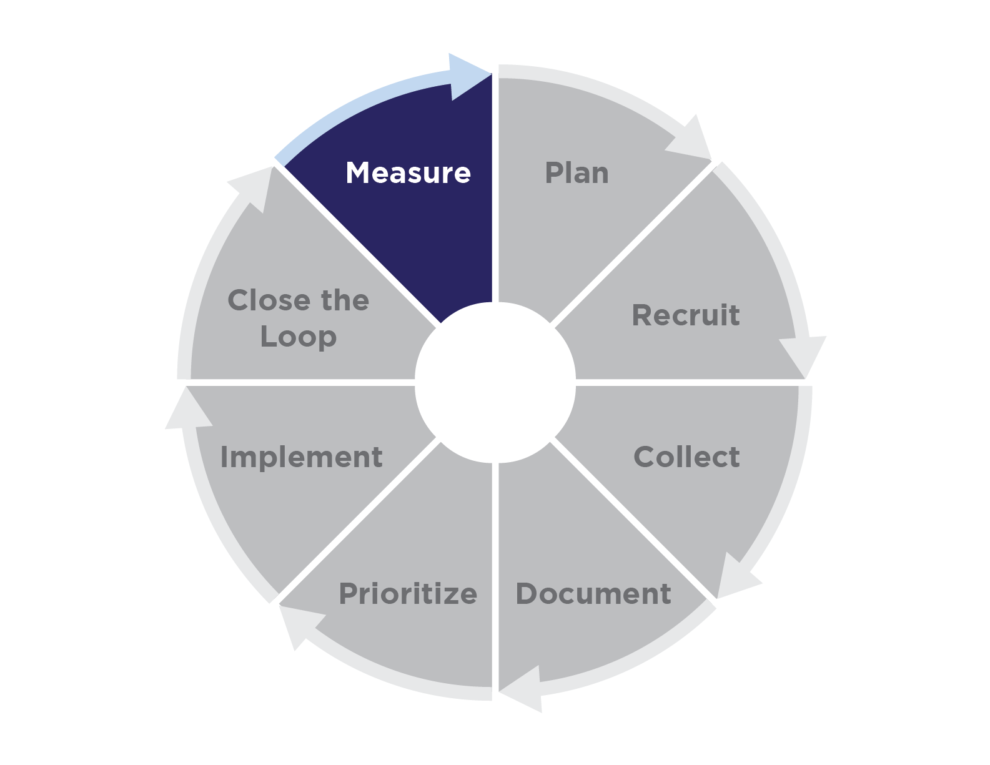
Measure
What to Do
Evaluate the impact of the stakeholder feedback.
Did the feedback address/prevent/mitigate the original problem/question?
Notes:
Note: This diagram was produced by the HHS/NIH All of Us Research Program.

Slide 30
Measure (continued)
Lessons Learned
Define what success looks like and how to measure success during the Plan step.
Determine when and how to collect success data based on the type of feedback and the stakeholders providing that feedback.
Notes:
Note: This diagram was produced by the HHS/NIH All of Us Research Program.

Slide 31
Impact of Stakeholder Feedback
31

Slide 32


Signs of Success: Impact of Stakeholder Feedback (1 of 3)
Comprehension Testing Results
Medicine and Your DNA Report 98%
Hereditary Disease Risk Report 97%
Cultural Awareness Committee
No launch-blocking feedback
Friends & Family Launch
No launch-blocking feedback
Notes:
Note: Illustration was produced by the HHS/NIH All of Us Research Program.

Slide 33

Signs of Success: Impact of Stakeholder Feedback (2 of 3)
Support Center
Approximately 9,500 relevant inquiries from participants*
<150 asking about health-related DNA results
28 asking about genetic counseling appointments
12 asking about insurance and DNA results
*September 2022 - February 2023
Notes:
Note: Illustration was produced by the HHS/NIH All of Us Research Program.

Slide 34
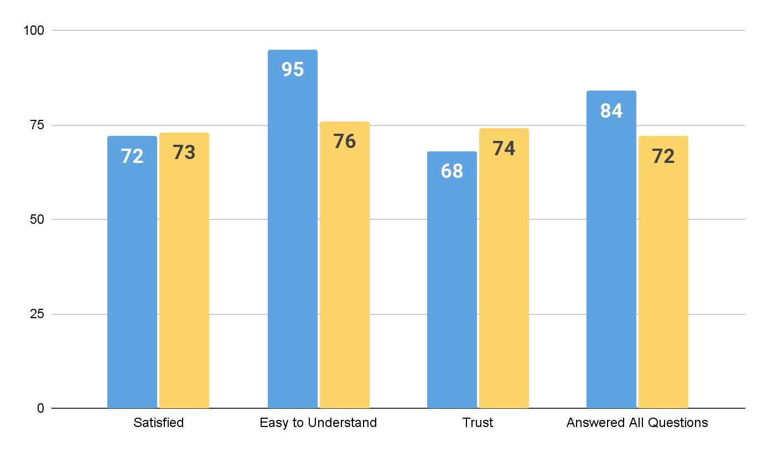
Signs of Success: Impact of Stakeholder Feedback (3 of 3)
Participant Satisfaction With DNA Results (%)*
Hereditary Disease Risk
Medicine and Your DNA
*November 2022 - March 2023

Slide 35
Acknowledgements
All of Us Research Program Divisions
Participating All of Us Program Partners
User Experience
Communications
Policy
Engagement and Retention
Research Compliance
Medical and Scientific Research
Product
Biobank at Mayo Clinic
Data & Research Center at Vanderbilt University
Genome Centers (Broad, Color, Baylor, Johns Hopkins, University of Texas, University of Washington)
Genetic Counseling Resource (Color Health)
Vibrent Health (participant portal)
Tactis (Support Center)
Wondros (user experience)

Slide 36






Thank You!
JoinAllofUs.org
AllofUs.nih.gov
@AllofUsResearch
#JoinAllofUs
36

